Slide 1

Module 5
Unity Input

Slide 2
Learning Objectives
Create a Unity game that processes mouse location input
Create a Unity game that processes mouse button input
Create a Unity game that processes keyboard input

Slide 3
Content (slot 1)
The Input Manager
Mouse Input
Exercise 18
Exercise 19
Keyboard Input
Exercise 20

Slide 4
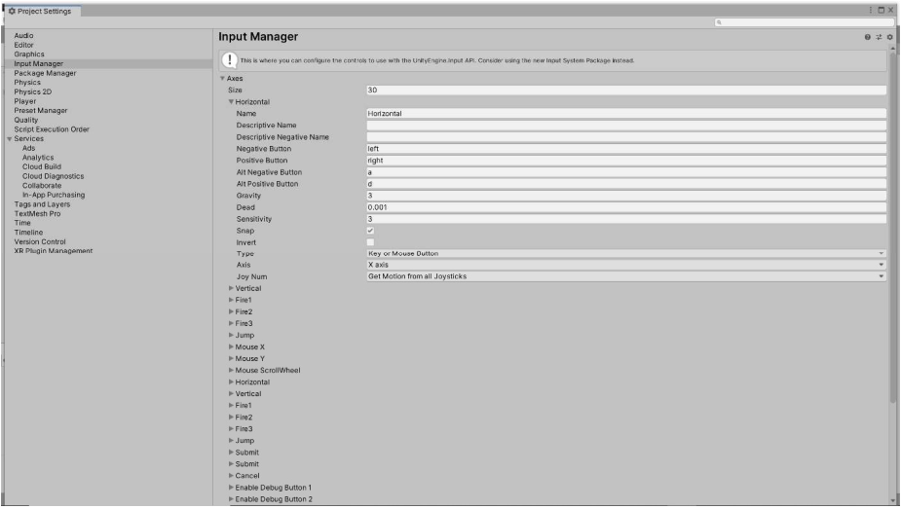
The Input Manager

Slide 5
5.1 The Input Manager
The Input Manager gives us the ability to configure a variety of input axes.
We can also add new axes as we need to..
The Name property lets us get the axis by name from a script.
Negative Button moves along the axis in the negative direction.
Positive Button moves along the axis in the positive direction.
Alt Negative Button and Alt Positive Button are additional buttons for those directions.

Slide 6
5.1 The Input Manager
The Type of input for an axis is:
Key or Mouse Button
Mouse Movement (which is the input type for the Mouse X and Mouse Y axes).
Joystick Axis (which we use for gamepad input).
The Axis value doesn't really matter if our input type is Key or Mouse Button, but we use X axis for horizontal input and Y axis for vertical input from Mouse Movement and Joystick Axis input types.
Joy Num only matters for the Joystick Axis input type, and it lets us filter which joystick(s) can control the given axis.

Slide 7
5.2 Mouse Input
How to make a teddy bear follow the mouse around the screen (1).
How to blow up the teddy bear (of course!) by pressing the left mouse button (2).
Create a new Unity 2D project:
import the teddy bear sprite and the explosion sprite sheet into a Sprites folder, and create empty Prefabs and Scripts folders.
The Input class exposes a mousePosition property that gives us the current position of the mouse (in screen coordinates) as a Vector3.

Slide 8
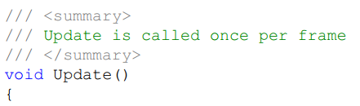
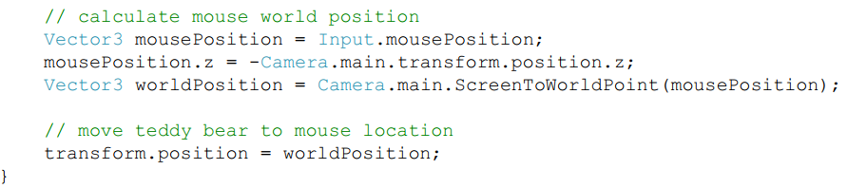
5.2 Mouse Input

Slide 9
5.2 Mouse Input
(1) To make the teddy bear stay on the screen even when the mouse goes outside the screen:
Create edge colliders around the sides of the screen.
Attach a Box Collider 2D to the TeddyBear and edit the collider boundaries so the collider fits tightly to the shape of the TeddyBear.
Check the left, right, top, and bottom edges of the collider on each frame to make sure they're not outside the screen. If they are, we'll clamp them to the appropriate edge of the screen.

Slide 10
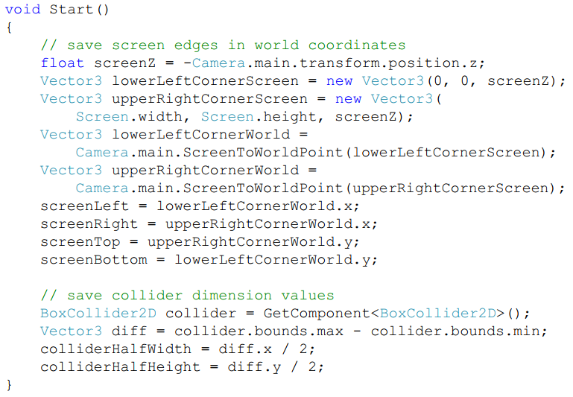
5.2 Mouse Input

Slide 11
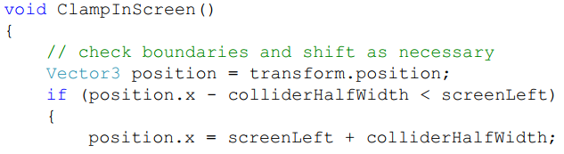
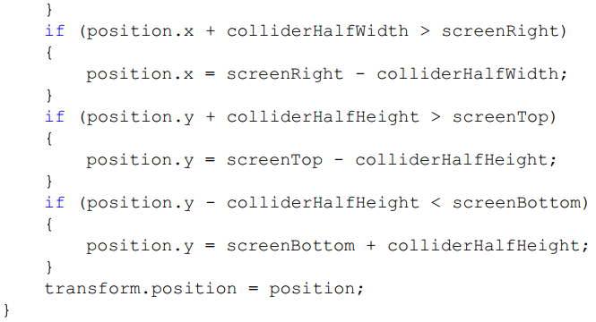
5.2 Mouse Input

Slide 12
5.2 Mouse Input
(2) To blow the TeddyBear up with the left mouse button.
Build an Explosion prefab

Slide 13
5.2 Mouse Input
Select the explosion sprite in the Sprites folder of the Project window and use the dropdown in the Inspector to change the Sprite Mode to Multiple.
Add an Animator component to the Explosion game object.
Create new empty Animations and Controllers folders in the Project window.
Implement the explosionController.
Click the Play button in the Unity editor to test the animation.
Although it's kind of fun to have explosions loop forever once they're added to our game, that's not very realistic, so we'll fix that now.

Slide 14
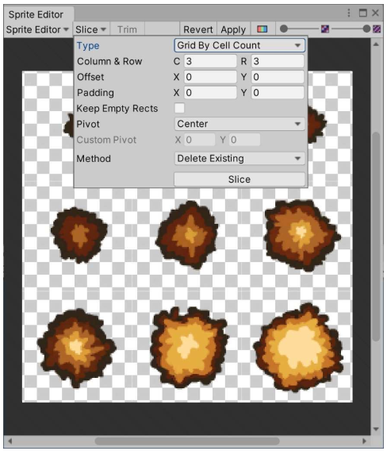
5.2 Mouse Input
Explosion in Sprite Editor

Slide 15
5.2 Mouse Input
Create a new Explosion script in the Scripts folder in the Project window and drag the script onto the Explosion game object in the Hierarchy window.

Slide 16
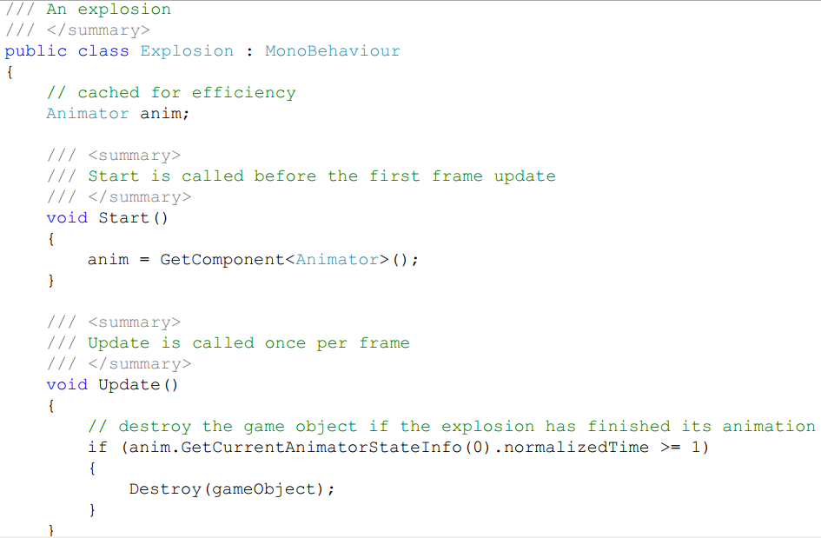
5.2 Mouse Input

Slide 17
5.2 Mouse Input
The normalizedTime field is a float, where the integer part is the number of times the animation has looped and the fractional part represents the percent progress in the current loop.
That means that when the normalizedTime hits 1, it has just completed the first loop through the animation frames.
Drag the Explosion game object from the Hierarchy window into the Prefabs folder in the Project window to create the prefab. Delete the Explosion game object from the Hierarchy window, because we'll be creating the Explosion at run time on a left click.

Slide 18
5.2 Mouse Input
Add a GameObject field called prefabExplosion to the TeddyBear class and mark is with [SerializeField].
Add a BlowUpTeddy (user-defined axis) axis in the Input Manager.
Set the Positive Button to space (we'll use that when we process keyboard input later in the chapter) and set the Alt Positive Button to mouse 0 (mouse button 0 is the left mouse button).
To access an input axis from a script, use the Input GetAxis method.

Slide 19
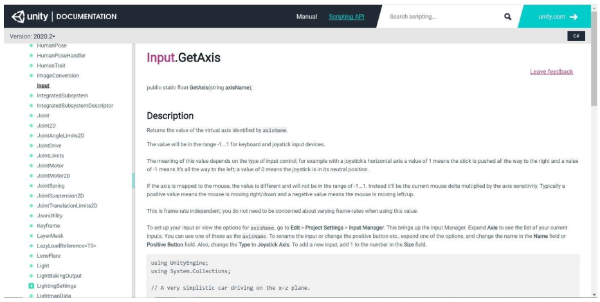
5.2 Mouse Input
GetAxis Documentation

Slide 20
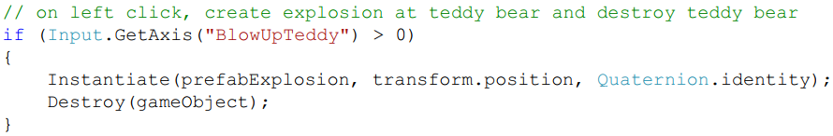
5.2 Mouse Input
To make the TeddyBear destroy itself on a left click, we add the following code to the end of the Update method:
Run the game to confirm that the teddy bear still follows the mouse around and that it explodes properly when you click the left mouse button. If it does, select the TeddyBear game object in the Hierarchy window and click the Overrides dropdown near the top of the Inspector and select Apply All so that the TeddyBear prefab has the Prefab Explosion field set properly.

Slide 21
Exercise 18: Mouse Jumping
Problem 1 - Create a project and add a sprite
Create a new 2D Unity project named Exercise18. Add a new scenes folder and save the current scene as scene0. Add a new sprites folder and use your Operating System to copy a sprite of your choosing into that folder. Drag the sprite into the Hierarchy window to create a game object in the scene. Run the game and watch nothing happen.
Problem 2 - Write the code
Create a new scripts folder and create a new C# script in that folder called Jumper. Open the new script in your IDE and add a documentation comment for the class. The Jumper class (script) jumps the game object to the mouse location when the left mouse button is pressed.
Delete the Start method from the script. Add code to the body of the Update method to implement the required behavior. The Mouse Button Processing lecture covers mouse button input processing in detail.
Problem 3 - Finish the game
Run the game to make sure it works properly. Swear because you didn't attach the script to anything.
Attach the script to your sprite game object and run the game again. Debug as necessary.

Slide 22
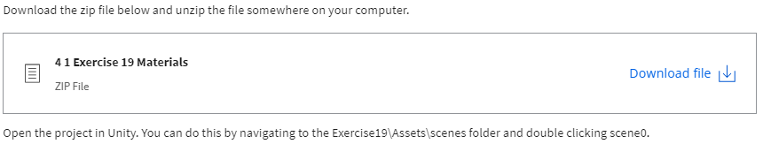
Exercise 19: Spawn and Explode
Problem 1 - Setting up the mouse button processer
Drag the MouseButtonProcessor script from the scripts folder in the Project window onto the Main Camera in the Hierarchy window. Left click the Main Camera in the Hierarchy window to select it.
Expand the prefabs folder in the Project window and drag the Explosion prefab onto the Prefab Explosion field in the Mouse Button Processor (Script) component in the Inspector. Drag the TeddyBear prefab onto the Prefab Teddy Bear field in the Mouse Button Processor (Script) component in the Inspector.

Slide 23
Exercise 19: Spawn and Explode
Problem 2 - Spawn teddy bear on left mouse button
Open the Input Manager, expand the Axes area if necessary, and add 1 to the value next to Size. Expand the bottom input axis (the one you just added) and change the Name to SpawnTeddyBear. Change the Positive Button to mouse 0 and delete the Alt Positive Button.
Open the MouseButtonProcessor script in your IDE.
Add code to the Update method to instantiate the teddy bear prefab at the mouse location when there's input on the SpawnTeddyBear axis. The Mouse Button Processing Revisited lecture discusses how to only respond on the first frame of input on an axis; you should use that approach here to make sure you only spawn a single teddy bear when the player presses the left mouse button. The Mouse Location Processing lecture shows how to determine the location of the mouse in world coordinates.
Test your code to make sure it works properly and debug as necessary.

Slide 24
Exercise 19: Spawn and Explode
Problem 3 - Explode a teddy bear on right mouse button
Open the Input Manager, expand the Axes area if necessary, and add 1 to the value next to Size. Expand the bottom input axis (the one you just added) and change the Name to ExplodeTeddyBear. Change the Positive Button to mouse 1 and delete the Alt Positive Button.
Open the MouseButtonProcessor script in your IDE.
Add code to the Update method to explode one of the teddy bears in the game. The Mouse Button Processing Revisited lecture discusses how to only respond on the first frame of input on an axis; you should use that approach here to make sure you only explode a single teddy bear when the player presses the right mouse button. I already tagged the TeddyBear prefab with a TeddyBear tag, so you can get one of the teddy bears in the game using the GameObjectFindWithTag method. Because that method can return null (if there are no teddy bears in the game), check for null before trying to blow up the teddy bear. If the teddy bear isn't null, instantiate the explosion prefab at the teddy bear's position and destroy the teddy bear.
Test your code to make sure it works properly and debug as necessary.

Slide 25
5.3 Keyboard Input
Change the TeddyBear Update method so we can move the teddy bear around with the keyboard instead of having it follow the mouse position.
Because of keyboard keys, which can only be pressed or not, the value we get back from a call to the GetAxis method for those axes will only be -1, 0, or 1.
So how do we use the value to actually move the TeddyBear? A good way to think about this is that the value is used to apply thrust to move the teddy bear in a particular direction?
add a moveUnitsPerSecond field to our TeddyBear class and mark it with [SerializeField].

Slide 26
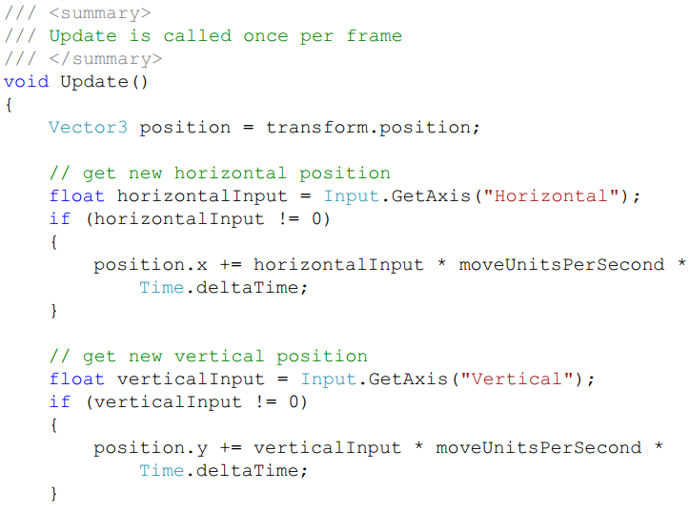
5.3 Keyboard Input
Make significant changes to the TeddyBear Update method:

Slide 27
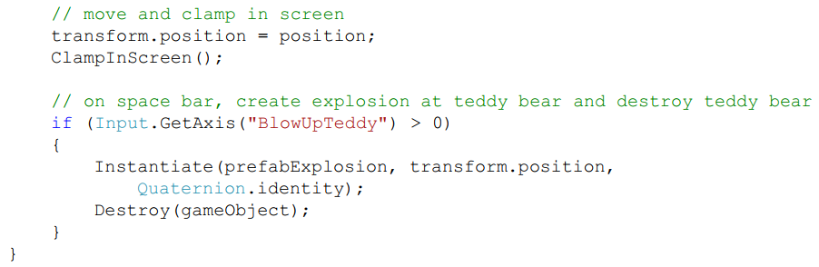
5.3 Keyboard Input

Slide 28
Exercise 20: Finally, a Driving Game
Problem 1 - Create a project and add a sprite
Create a new 2D Unity project named Exercise20. Add a new scenes folder and save the current scene as scene0. Add a new sprites folder and use your Operating System to copy a sprite of your choosing into that folder. Drag the sprite into the Hierarchy window to create a game object in the scene. Run the game and watch nothing happen.
Problem 2 - Drive horizontally
Create a new scripts folder and create a new C# script in that folder called Driver. Open the new script in your IDE and add a documentation comment for the class. The Driver class (script) drives the game object based on keyboard input.
Add a constant called MoveUnitsPerSecond to store how many units your game object moves per second below the line that starts public class. Delete the Start method from the script. Add code to the body of the Update method to save the value on the Horizontal input axis (already provided in the default Unity project) into a variable called horizontalInput and to check if that value is non-zero. If there is input on that axis, change the x position of the game object (using a local variable as usual). The appropriate amount to change the x position is horizontalInput∗MoveUnitsPerSecond∗Time.deltaTime. The Keyboard Processing lecture covers keyboard input processing in detail.
Attach the Driver script to your game object in the Hierarchy window and run the game to drive horizontally.

Slide 29
Exercise 20: Finally, a Driving Game
Problem 3 - Drive vertically
Add code to the body of the \tt{Update}Update method to handle input on the Vertical input axis (already provided in the default Unity project) to change the y position of the game object.
Run the game to drive vertically (and horizontally if you'd like).

Slide 30
Content (part 2)
Gamepad Input
Putting It All Together

Slide 31
5.4 Gamepad Input
Processing gamepad input is very similar to processing keyboard input.
We'll use a 360 controller as our gamepad, but Unity supports a wide variety of controllers.
By default, our Unity game contains 2 Horizontal axes: one with Type set to Key or Mouse Button and one with Type set to Joystick Axis.
In fact, we get 2 of many of the default axes, which makes it very easy to port the input processing from mouse/keyboard input to gamepad input.
In our current example, we don't even need to change any code to do that.
We still need to add another axis to blow up the teddy bear using a joystick button.

Slide 32
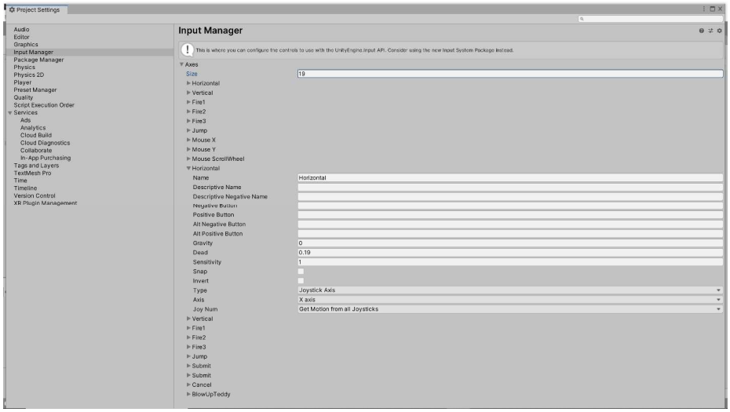
5.4 Gamepad Input
Joystick Horizontal Axis

Slide 33
5.4 Gamepad Input
Because each input axis can only have two positive buttons (Positive Button and Alt Positive Button), and because our BlowUpTeddy axis already uses both of them for the space bar and the left mouse button, we don't have any more room in that axis.
The good news is that we can create another axis with the same name to detect the joystick button press. When we call the GetAxis method in our script, it gets the input from all the axes with the name we provided; that's why we can have two Horizontal axes in the default game.

Slide 34
5.4 Gamepad Input
Add another input axis called BlowUpTeddy, set the Positive Button to joystick button 0 and make sure the Alt Positive Button is blank.
Make sure the Type is set to Key or Mouse Button, which is used for joystick buttons as well. We know we're not trying to use a Joystick Axis to blow up the teddy bear, we're trying to use a joystick button.
By the way, on a 360 controller joystick button 0 is A, joystick button 1 is B, and so on.

Slide 35
5.5 Putting It All Together
The problem description:
The player uses the keyboard to drive a fish around the game world, eating teddy bears with the head of the fish. The teddy bears bounce off the sides of the screen as they move around until they're eaten by the fish, at which point they're removed from the game. If a collision between the fish and a teddy bear isn't at the head of the fish, the teddy bear bounces off the fish. Teddy bears spawn at random intervals between 1 and 2 seconds.
Understand the Problem:
There are lots of details to work out as we build the game, but the rules of the game seem pretty straightforward, so we can move on to our design.

Slide 36
5.5 Putting It All Together
Design a Solution:
We only need two game objects in the game: TeddyBear and Fish.
The TeddyBear game object behaves just as it did in the “game” in module 4.6, so we'll just reuse the TeddyBear script and all the game object components we used there here as well. We'll also reuse the TeddyBearSpawner and Timer scripts from our solution to that problem.
To the Fish game object, we're definitely going to need a new Fish script to implement the required functionality. There are two key pieces of functionality we need in the Fish game object:
moving and facing the right way based on player input
handling collisions with TeddyBear game objects properly.

Slide 37
5.5 Putting It All Together
Design a Solution:
Because the Fish game object movement is like the TeddyBear game object responding to keyboard input, we'll start with the fields for the movement amount, fish collider dimensions, and the screen edges.
Because we need different sprites for facing left and facing right, we'll include fields for each of those sprites. Because we'll need a reference to the SpriteRenderer component every time we need to change the sprite, we'll store that in a field for efficiency.
For methods, we'll need the Start method to initialize lots of our fields and Update and ClampInScreen methods to respond to player input.

Slide 38
5.5 Putting It All Together
Design a Solution:
Although it might make sense to you that we should use the Update method for this, we should use the OnCollisionEnter2D method instead. That's because the OnCollisionEnter2D method is called “when an incoming collider makes contact with this object's collider.”

Slide 39

5.5 Putting It All Together
Design a Solution:
MonoBehaviour Messages (Methods)

Slide 40
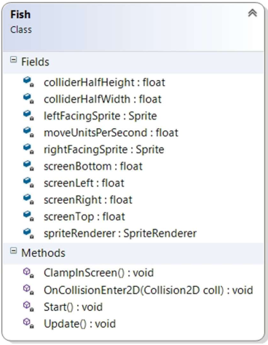
5.5 Putting It All Together
Design a Solution:
Fish UML

Slide 41
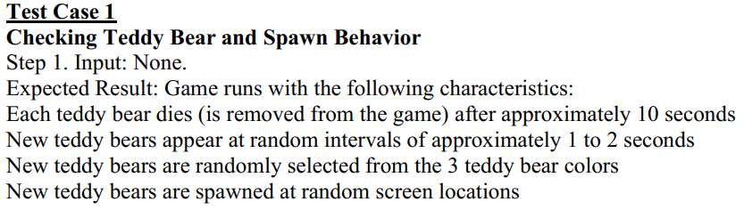
5.5 Putting It All Together
Write Test Cases

Slide 42
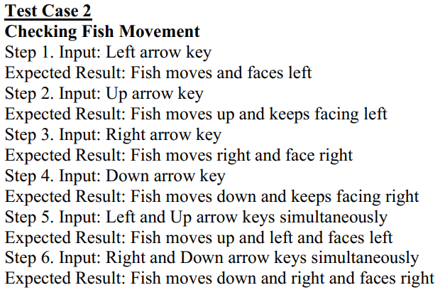
5.5 Putting It All Together
Write Test Cases

Slide 43
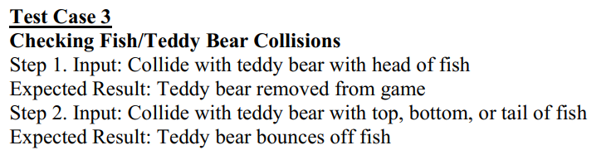
5.5 Putting It All Together
Write Test Cases

Slide 44
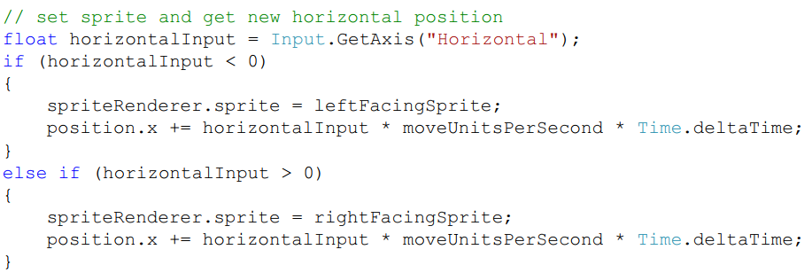
5.5 Putting It All Together
Write the Code
change the code in the Update method that moves the fish based on Horizontal input:

Slide 45
5.5 Putting It All Together
Write the Code
All we have left is making it so the fish can eat teddy bears with its head.
Do that in the OnCollisionEnter2D method.
When we detect a collision with a teddy bear, if the collider for the teddy bear intersects with the bounding box at the fish's head, we'll eat (destroy) the teddy bear.
When a collision occurs, we'll have to first move the fish head bounding box to the appropriate side of the fish (the left if the fish is facing left and the right if the fish is facing right).
If we look at the method header for the OnCollisionEnter2D method, we see there's a Collision2D object as the only parameter. The Collision2D documentation shows that we can access the collider property of that object to get the teddy bear's collider.

Slide 46
5.5 Putting It All Together
Write the Code
The collider is a Collider2D object, which has a bounds property of type Bounds for the “world space bounding area of the collider.”
Bounds objects are bounding boxes, so if we have Bounds objects for the teddy bear collider and the fish head, we can check to see if they intersect to determine whether or not the collision occurred at the head of the fish.

Slide 47

5.5 Putting It All Together
Write the Code
Bounds Documentation

Slide 48
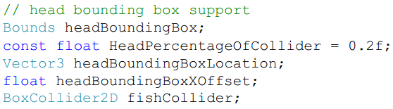
5.5 Putting It All Together
Write the Code
Add several fields to the Fish class:
The headBoundingBox field holds the bounding box for the fish's head.
The HeadPercentageOfCollider tells us how much of the fish collider represents the head of the fish.
The headBoundingBoxLocation field is used to to move the bounding box to the correct side of the fish on a collision.
The headBoundingBoxXOffset saves the x offset we need to apply from the center of the collider to move the bounding box the correct amount to get it to the front of the fish.

Slide 49
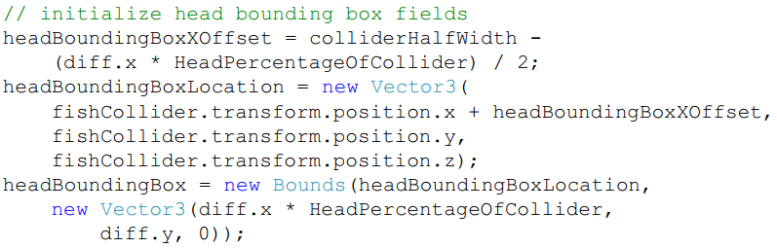
5.5 Putting It All Together
Write the Code
The fishCollider is a reference to the BoxCollider2D component of the Fish so we don't have to look that up every time we have a collision.
Add code to the Start method to initialize these fields:

Slide 50
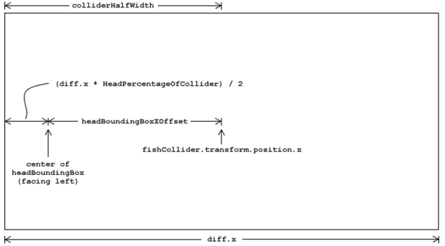
5.5 Putting It All Together
Write the Code
Head Bounding Box X Offset Calculation

Slide 51
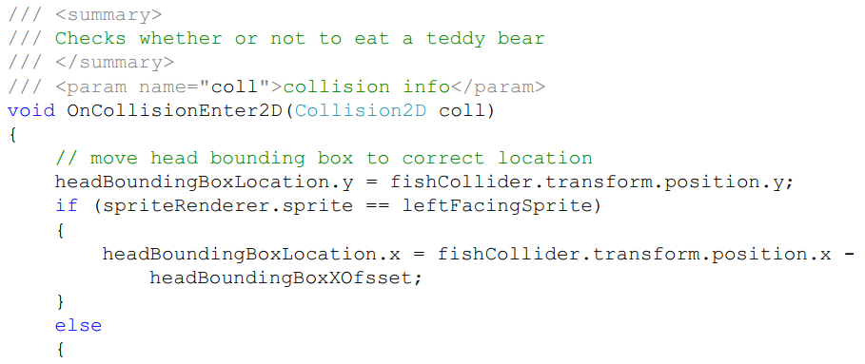
5.5 Putting It All Together
Write the Code

Slide 52
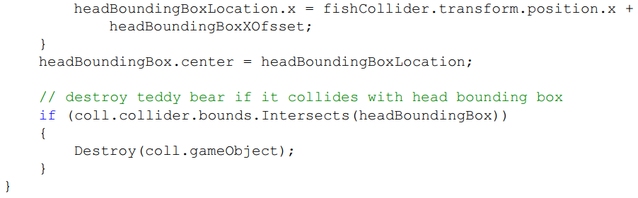
5.5 Putting It All Together
Write the Code

Slide 53
5.5 Putting It All Together
Test the Code
Test case 1
Test case 2
Test case 3

Slide 54
Summary
The Input Manager
Mouse Input
Keyboard Input
Gamepad Input

